Slide 1
Principal Component Analysis
CS771: Introduction to Machine Learning
Purushottam Kar

Slide 2

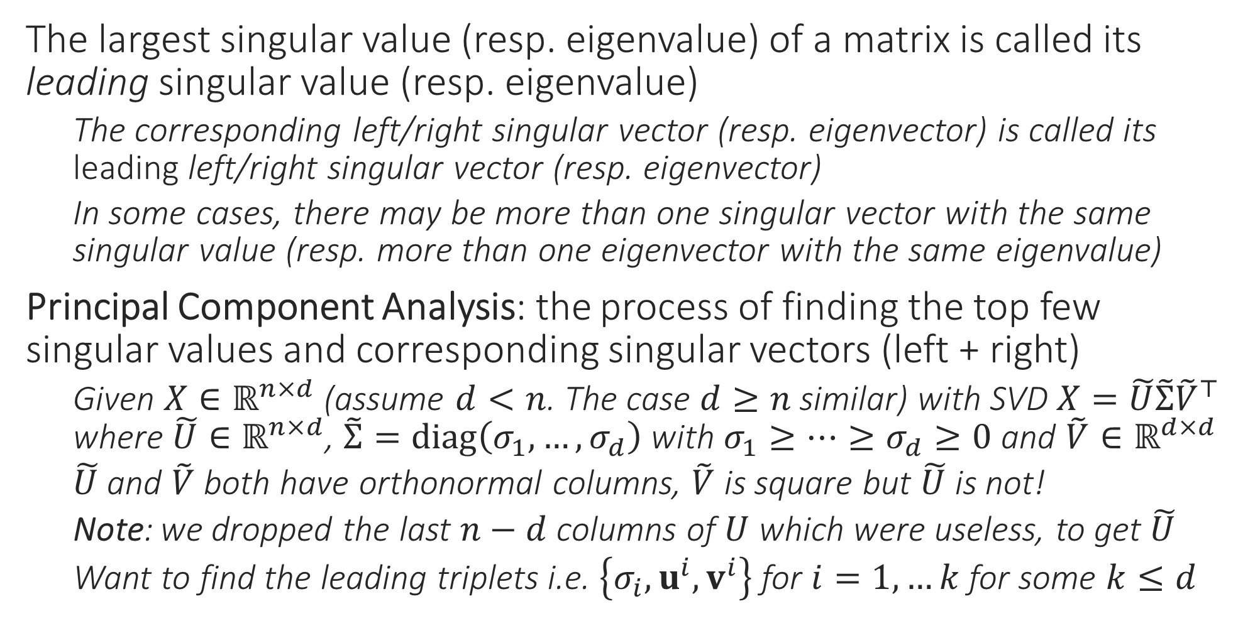
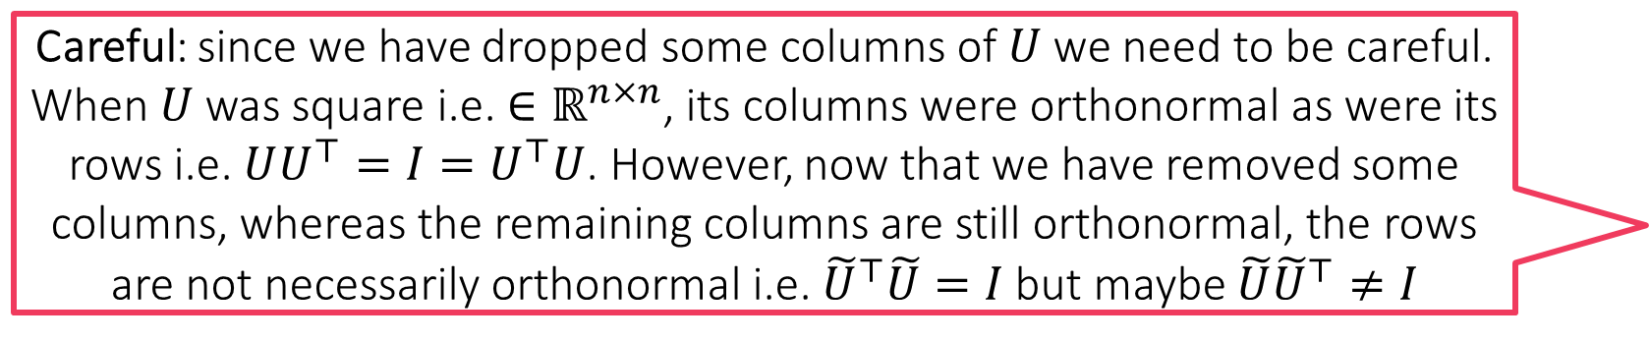
Principal Component Analysis
Careful: since we have dropped some columns of $U$ we need to be careful. When $U$ was square i.e. ${∈ℝ}^{n×n}$, its columns were orthonormal as were its rows i.e. $UU^{⊤}=I=U^{⊤}U$. However, now that we have removed some columns, whereas the remaining columns are still orthonormal, the rows are not necessarily orthonormal i.e. ${\tilde{U}}^{⊤}\tilde{U}=I$ but maybe $\tilde{U}{\tilde{U}}^{⊤}≠I$
The largest singular value (resp. eigenvalue) of a matrix is called its leading singular value (resp. eigenvalue)
The corresponding left/right singular vector (resp. eigenvector) is called its leading left/right singular vector (resp. eigenvector)
In some cases, there may be more than one singular vector with the same singular value (resp. more than one eigenvector with the same eigenvalue)
Principal Component Analysis: the process of finding the top few singular values and corresponding singular vectors (left + right)
Given $X∈ℝ^{n×d}$ (assume $d<n$. The case $d≥n$ similar) with SVD $X=\tilde{U}\tilde{Σ}{\tilde{V}}^{⊤}$ where $\tilde{U}∈ℝ^{n×d}$, $\tilde{Σ}=diag\left(σ_{1},…,σ_{d}\right)$ with $σ_{1}≥…≥σ_{d}≥0$ and $\tilde{V}∈ℝ^{d×d}$
$\tilde{U}$ and $\tilde{V}$ both have orthonormal columns, $\tilde{V}$ is square but $\tilde{U}$ is not!
Note: we dropped the last $n−d$ columns of $U$ which were useless, to get $\tilde{U}$
Want to find the leading triplets i.e. $\left\{σ_{i},u^{i},v^{i}\right\}$ for $i=1,…k$ for some $k≤d$

Slide 3
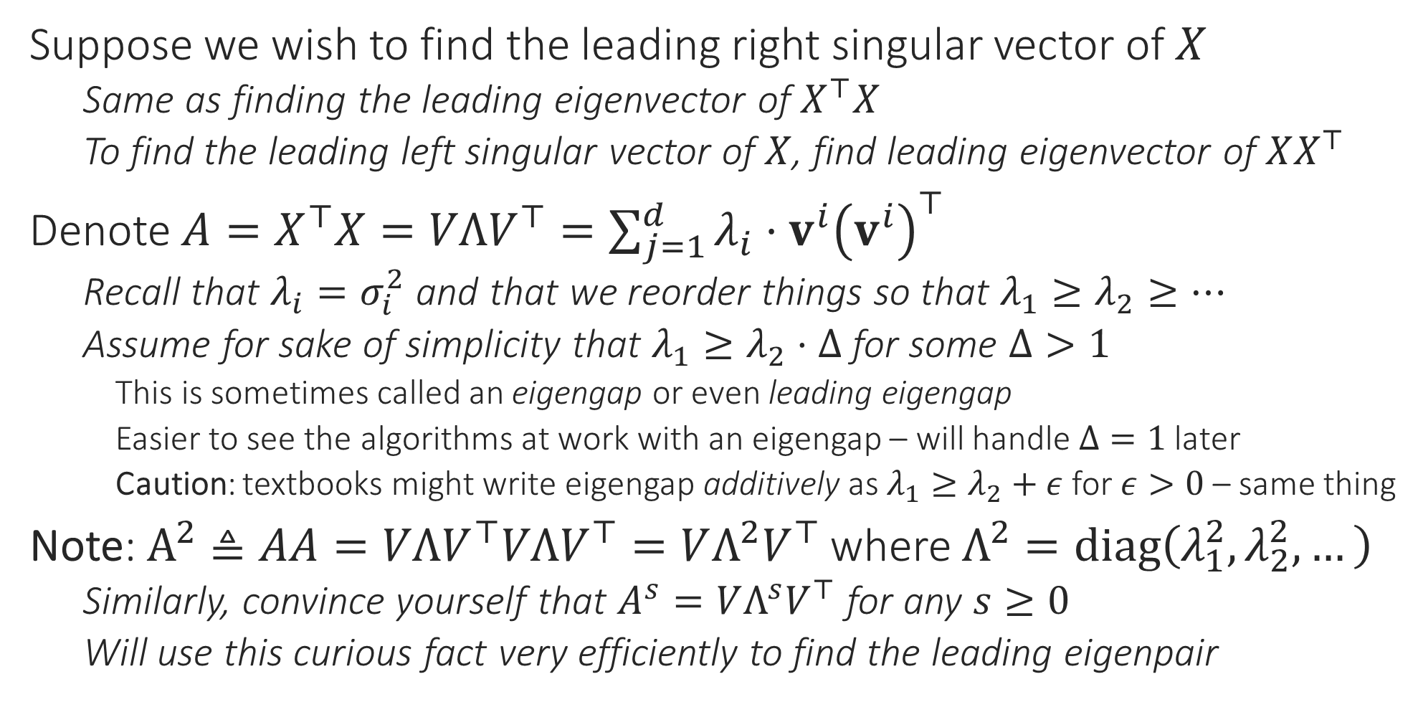
Principal Component Analysis
Suppose we wish to find the leading right singular vector of $X$
Same as finding the leading eigenvector of $X^{⊤}X$
To find the leading left singular vector of $X$, find leading eigenvector of $XX^{⊤}$
Denote $A=X^{⊤}X=VΛV^{⊤}=\sum_{j=1}^{d}{λ_{i}⋅v^{i}{\left(v^{i}\right)}^{⊤}}$
Recall that $λ_{i}=σ_{i}^{2}$ and that we reorder things so that $λ_{1}≥λ_{2}≥…$
Assume for sake of simplicity that $λ_{1}≥λ_{2}⋅Δ$ for some $Δ>1$
This is sometimes called an eigengap or even leading eigengap
Easier to see the algorithms at work with an eigengap – will handle $Δ=1$ later
Caution: textbooks might write eigengap additively as $λ_{1}≥λ_{2}+ε$ for $ε>0$ – same thing
Note: $A^{2}≜AA=VΛV^{⊤}VΛV^{⊤}=VΛ^{2}V^{⊤}$ where $Λ^{2}=diag\left(λ_{1}^{2},λ_{2}^{2},…\right)$
Similarly, convince yourself that $A^{s}=VΛ^{s}V^{⊤}$ for any $s≥0$
Will use this curious fact very efficiently to find the leading eigenpair

Slide 4


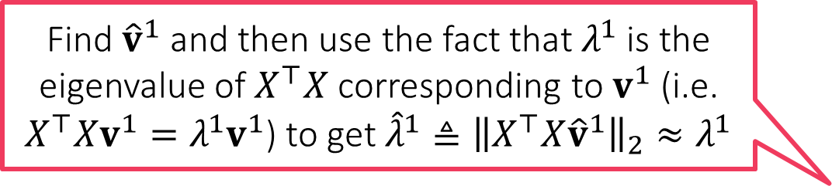




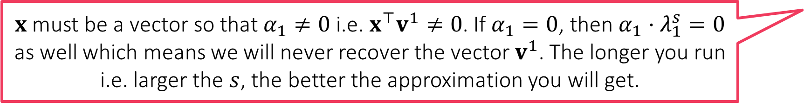
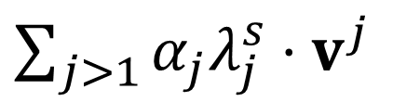

The Power Method
How do I find our $λ_{1}$?
Note that if $λ_{1}≥λ_{2}⋅Δ$, then $λ_{1}^{s}≥λ_{2}^{s}⋅Δ^{s}$ for $s≥1$
Note that this means $λ_{1}^{s}≥λ_{j}^{s}⋅Δ^{s}$ for all $j≥2$ as well
Even if $Δ=1.1$, with large enough $s$, gap blows up e.g. ${1.1}^{100}>10000$
Thus, with large $s$, the leading eigenvalue really stands out!
Let us take a vector $x∈ℝ^{d}$ and let $α=V^{⊤}x$
The vector $α$ represents $x$ in terms of columns of $V$ i.e. $x=\sum_{j=1}^{d}{α_{j}⋅v^{j}}$
Notice that since $V$ is orthonormal, we have $VV^{⊤}x=x$
This means $A^{s}x=VΛ^{s}V^{⊤}x=VΛ^{s}α=$
However, we just saw that $λ_{1}^{s}≫λ_{j}^{s}$ for all $j≥2$
This means that $A^{s}x≈α_{1}λ_{1}^{s}⋅v^{1}$ which means that ${\hat{v}}^{1}≜\frac{A^{s}x}{{\left\|A^{s}x\right\|}_{2}}≈v^{1}$
Hmm … this means if our approximation ${\hat{v}}^{1}$ is not good then our approximation ${\hat{λ}}^{1}$ wont be good either
Find ${\hat{v}}^{1}$ and then use the fact that $λ^{1}$ is the eigenvalue of $X^{⊤}X$ corresponding to $v^{1}$ (i.e. $X^{⊤}Xv^{1}=λ^{1}v^{1}$) to get ${\hat{λ}}^{1}≜{\left\|X^{⊤}X{\hat{v}}^{1}\right\|}_{2}≈λ^{1}$
$x$ must be a vector so that $α_{1}≠0$ i.e. $x^{⊤}v^{1}≠0$. If $α_{1}=0$, then $α_{1}⋅λ_{1}^{s}=0$ as well which means we will never recover the vector $v^{1}$. The longer you run i.e. larger the $s$, the better the approximation you will get.
$$α_{1}λ_{1}^{s}⋅v^{1}+$$
$\sum_{j>1}{α_{j}λ_{j}^{s}⋅v^{j}}$
We obtained our approximation as ${\hat{v}}^{1}≜\frac{A^{s}x}{{\left\|A^{s}x\right\|}_{2}}$. How should we choose $x$? Will any $x$ work? How should we choose $s$?

Slide 5
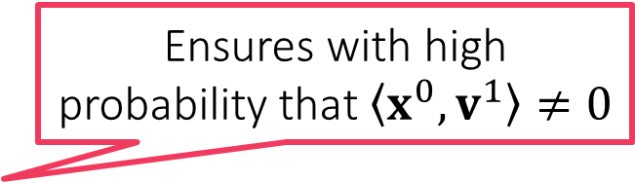
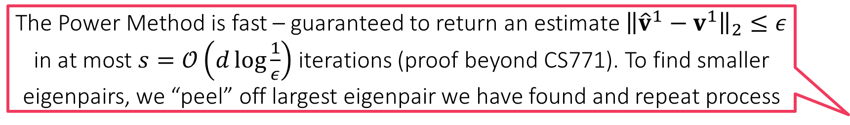
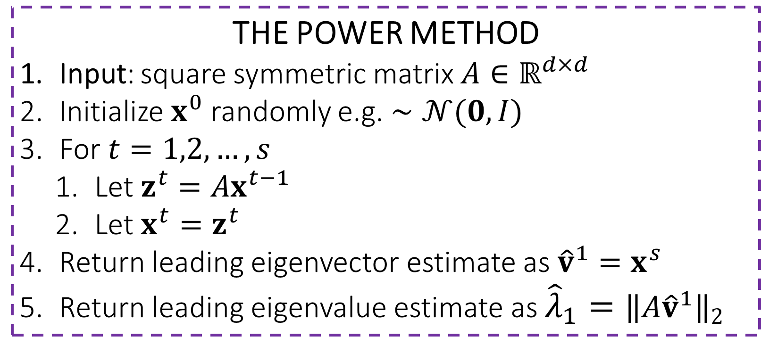

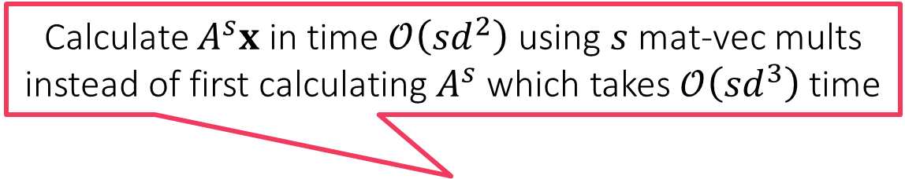

The Power Method
THE POWER METHOD
Input: square symmetric matrix $A∈ℝ^{d×d}$
Initialize $x^{0}$ randomly e.g. $∼𝒩(0,I)$
For $t=1,2,…,s$
Let $z^{t}=Ax^{t−1}$
Let $x^{t}=z^{t}$
Return leading eigenvector estimate as ${\hat{v}}^{1}=x^{s}$
Return leading eigenvalue estimate as ${{\hat{λ}}_{1}=\left\|A{\hat{v}}^{1}\right\|}_{2}$
Calculate $A^{s}x$ in time $𝒪\left(sd^{2}\right)$ using $s$ mat-vec mults instead of first calculating $A^{s}$ which takes $𝒪\left({sd}^{3}\right)$ time
Ensures with high probability that $\left\langle x^{0},v^{1}\right\rangle ≠0$
Good to periodically normalize to prevent overflow errors
$$/{\left\|z^{t}\right\|}_{2}$$
Can show that doesn’t affect the working of the algo in any way
$$/{\left\|x^{s}\right\|}_{2}$$
The Power Method is fast – guaranteed to return an estimate ${\left\|{\hat{v}}^{1}−v^{1}\right\|}_{2}≤ε$ in at most $s=𝒪\left(d\log{\frac{1}{ε}}\right)$ iterations (proof beyond CS771). To find smaller eigenpairs, we “peel” off largest eigenpair we have found and repeat process
In settings with no eigengap, it turns out that there is an entire subspace (i.e. infinitely many eigenvectors) corresponding to the largest eigenvalue
Power Method will return some vector in that subspace but not sure which

Slide 6



The Peeling Method
THE PEELING METHOD
Input: square symmetric matrix $A∈ℝ^{d×d}$
Initialize $A^{0}←A$
For $j=1,…,k$
Let $\left({\hat{λ}}_{j},{\hat{v}}_{j}\right)←\text{POWER}\text{−}\text{METHOD}\left(A^{j−1}\right)$
Let $A^{j}←A^{j−1}−{\hat{λ}}_{j}⋅{\hat{v}}_{j}{\left({\hat{v}}_{j}\right)}^{⊤}$
Return ${\left\{{\hat{λ}}_{j},{\hat{v}}_{j}\right\}}_{j=1}^{k}$
Takes overall $𝒪\left(kd^{2}s\right)$ time to return the top $k$ leading eigenpairs of $A$
The “peeling” step
After leading eigenpair is peeled off, the eigenpair with the second largest eigenvalue becomes the new leading pair and Power Method can now recover this
Some residue might still be left due to inaccurate estimation of $λ_{j},v^{j}$ but usually small if $s$ sufficiently large
$$A=λ_{1}{\text{v}}^{1}{\left({\text{v}}^{1}\right)}^{⊤}+λ_{2}{\text{v}}^{2}{\left({\text{v}}^{2}\right)}^{⊤}+λ_{3}{\text{v}}^{3}{\left({\text{v}}^{3}\right)}^{⊤}+λ_{4}{\text{v}}^{4}{\left({\text{v}}^{4}\right)}^{⊤}+…$$

